Slide 1

Employee Management System
A Full-Stack Web Application Built with the MERN Stack
Intern
Course
College
Subashree R
B.E. Computer Science & Engineering
Chettinad College of Engineering and Technology
Internship
Full-Stack Web Development Internship

Slide 2


Introduction
An Employee Management System (EMS) is a centralized digital platform that enables organizations to efficiently store, manage, and retrieve employee information. From onboarding to performance tracking, an EMS serves as the backbone of modern HR operations.
Centralized Data
All employee records stored in one secure, accessible location — eliminating scattered spreadsheets and manual files.
Organizational Efficiency
Streamlines HR workflows, reduces administrative overhead, and frees up time for strategic decision-making.
Data Security
Ensures sensitive employee information is protected with authentication controls and structured access policies.

Slide 3
Problem Statement
Traditional manual approaches to employee management create significant operational bottlenecks. Organizations relying on paper records or isolated spreadsheets face recurring challenges that hinder productivity and data integrity.
⚠ Manual & Error-Prone Processes
⚠ Data Inconsistency
⚠ Lack of Accessibility
Without a unified system, duplicate records, outdated information, and conflicting data across departments become commonplace — leading to poor decision-making and compliance risks.
Physical files and disconnected tools make it difficult for HR teams to quickly retrieve or update records, especially in multi-location or remote work environments where real-time access is critical.
Maintaining employee records by hand is time-consuming, prone to human error, and difficult to scale as an organization grows. Simple tasks like updating contact details or tracking attendance require disproportionate effort.

Slide 4

Project Objectives
This project was designed with three core goals in mind — to replace inefficient manual processes with a reliable, scalable digital solution built on modern web technologies.
Automate Employee Data Handling
Enable seamless creation, retrieval, updating, and deletion of employee records through an intuitive interface powered by RESTful APIs.
Improve Operational Efficiency
Reduce time spent on administrative HR tasks by providing instant access to structured data, smart search, and real-time updates.
Ensure Secure Data Management
Implement authentication mechanisms and structured data models to protect sensitive employee information from unauthorized access.

Slide 5
Technology Stack — MERN
The MERN stack is a powerful combination of four JavaScript-based technologies that together enable the development of a full-stack web application — from the database layer to the user interface.
MongoDB
Express.js
NoSQL document database. Stores employee records as flexible JSON-like documents, enabling fast queries and easy scalability.
Lightweight Node.js framework for building robust RESTful APIs. Handles routing, middleware, and HTTP request/response cycles.
React.js
Node.js
Component-based frontend library. Delivers a dynamic, responsive user interface with real-time state management and smooth UX.
JavaScript runtime built on Chrome's V8 engine. Powers the server side, enabling non-blocking, event-driven architecture for high performance.

Slide 6

System Architecture
The application follows a classic three-tier architecture, where the React frontend communicates with the Express/Node.js backend via REST APIs, and the backend interacts with the MongoDB database to persist and retrieve data.
React.js Frontend
User interface, forms, dashboard
Three-layer System Architecture
MongoDB Database
Express + Node.js Backend
Employee collections, user data
REST API, business logic, auth
This clean separation of concerns ensures modularity, making the system easier to maintain, test, and extend with new features over time.

Slide 7
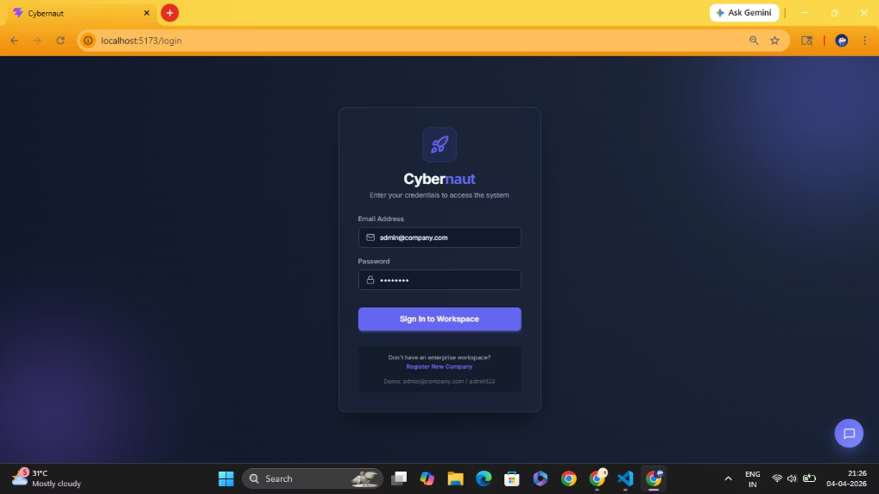
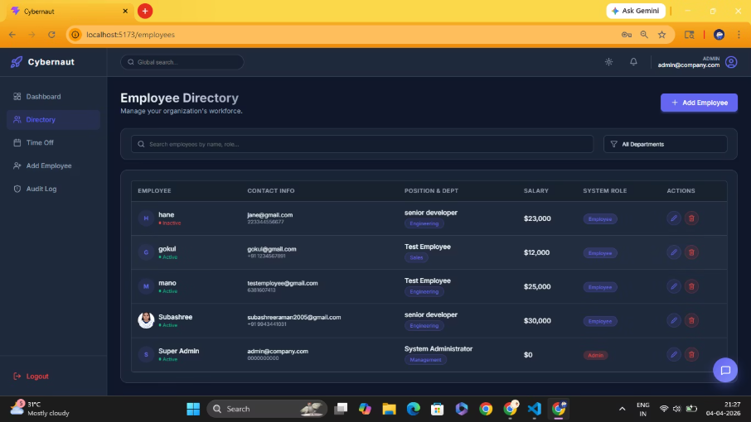
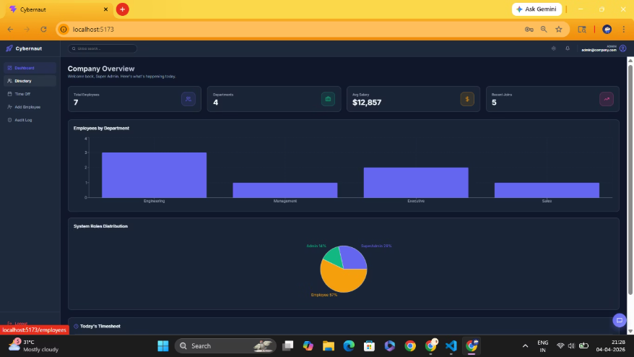
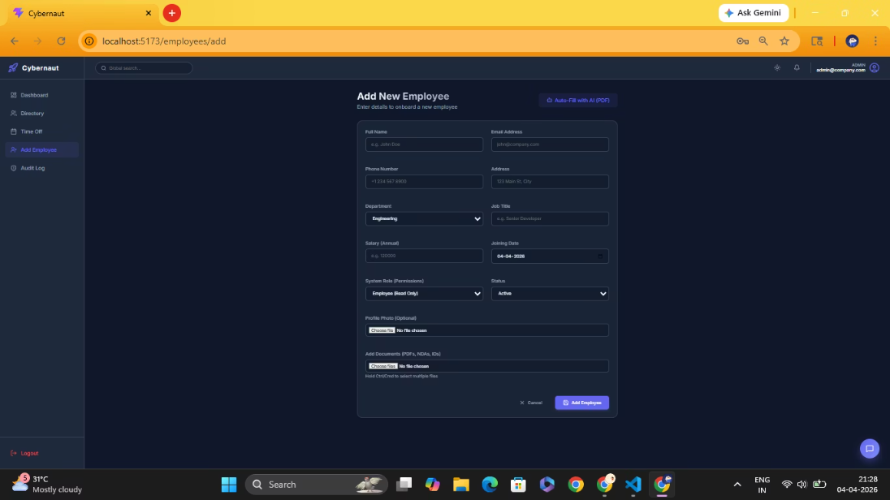
Output:

Slide 8




Core Features
Add Employee
View & Search
Update Details
Auth & Delete
A structured form to capture and submit new employee data including name, department, role, and contact details directly to the database.
Browse a paginated employee directory with real-time search and filter capabilities, pulling live data from the MongoDB backend.
Edit and save changes to existing employee records through a pre-populated form, ensuring accurate and up-to-date information at all times.
Secure login with JWT-based authentication protects the system, while authorized users can permanently remove employee records as needed.

Slide 9
Implementation Overview
The project was developed in three interconnected layers — each built independently but designed to work together as a cohesive full-stack application.
Frontend — React.js
Backend — Express & Node.js
Component-based UI structure
React Router for page navigation
Axios for API communication
useState & useEffect hooks for state and lifecycle management
Responsive layout with CSS/Bootstrap
RESTful API endpoints (GET, POST, PUT, DELETE)
Mongoose ODM for MongoDB interaction
JWT middleware for protected routes
CORS enabled for cross-origin requests
Database — MongoDB
Employee schema with structured fields
Collections for users and employee records
Atlas cloud deployment for remote access

Slide 10

Challenges Faced
Every real-world project brings technical hurdles. These challenges were valuable learning opportunities that sharpened problem-solving and debugging skills throughout the development process.
1
2
Frontend–Backend Integration
Debugging Async Errors
Resolving CORS policy issues and correctly configuring Axios base URLs to ensure the React frontend communicated seamlessly with the Express API across different environments.
Handling asynchronous operations, Promise chains, and async/await properly to avoid unhandled rejections and race conditions during API calls and state updates.
3
Database Schema Design
Designing flexible yet structured Mongoose schemas to accommodate varying employee data requirements while maintaining data validation and referential integrity.

Slide 11

Future Enhancements & Conclusion
Planned Enhancements
Conclusion & Key Takeaways
Role-Based Access Control
This project successfully demonstrates a functional, full-stack Employee Management System built entirely with the MERN stack. It addresses real organizational pain points through automation, structured data handling, and secure access.
Separate dashboards and permissions for Admin, HR, and Employee roles — ensuring each user only sees relevant data and actions.
Learning Outcomes:
Payroll Management Module
End-to-end full-stack development with JavaScript
REST API design and integration patterns
MongoDB schema design with Mongoose
React component architecture and state management
JWT-based authentication implementation
Integrate salary calculations, tax deductions, and payslip generation directly within the system for end-to-end HR management.
Attendance & Leave Tracking
Real-time attendance logging and leave request workflows to give HR teams complete visibility over workforce availability.
This internship project has provided hands-on experience that bridges academic knowledge with real-world software engineering practice.

